Slide 1
Data Science for Funsies! Brian Cornet
March 24th, 2021

Slide 2
Here’s what’s up!

Slide 3
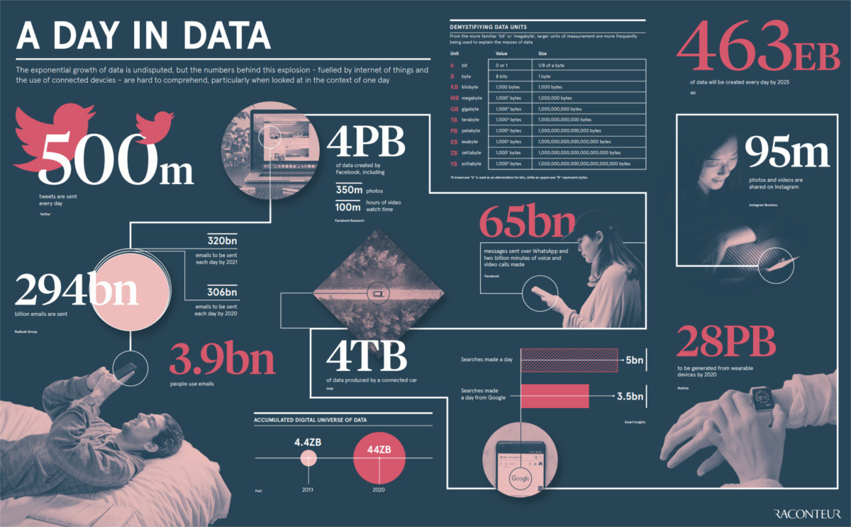
Data Science in the Real World
Data Science: a huge, growing field for analyzing and predicting trends. Used in research, business, etc. with countless opportunities and high pay.
Real data sets are HUGE!
Millions, billions, and yes, kajillions of rows or entries
Hundreds of columns or attributes to consider
Often spans multiple sets or introduces new data in real-time
Notes:
https://www.weforum.org/agenda/2019/04/how-much-data-is-generated-each-day-cf4bddf29f/

Slide 4
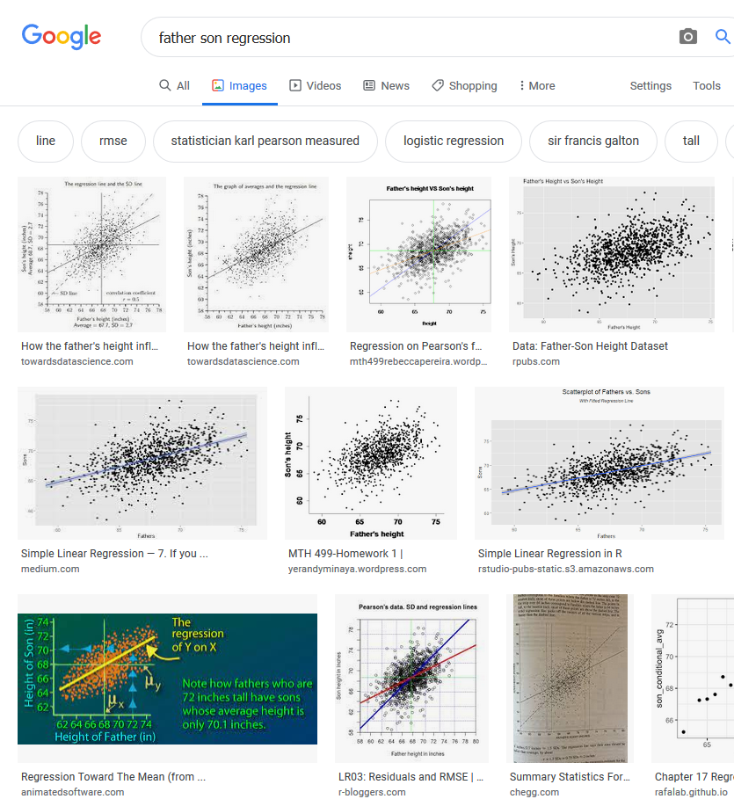
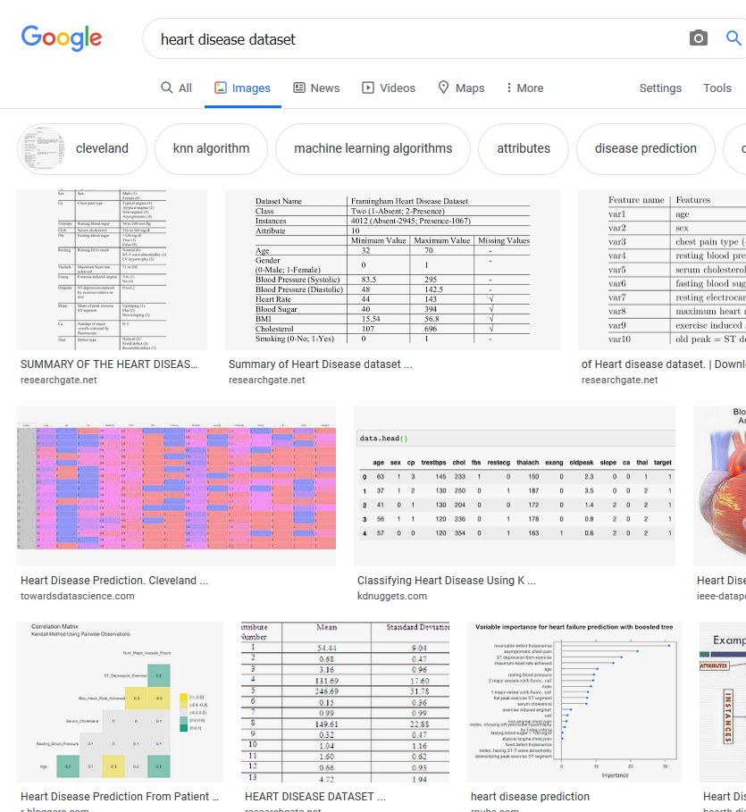
Data Science in Education
Typically uses small, curated, uninteresting data sets for easy reproducibility and evaluation
As introductory material, it’s okay, but we can do better!

Slide 5
But how can we do better?

Slide 6
Make it Personal!
Things
You Know
Things
You Excel In
Things
You Care About

Slide 7
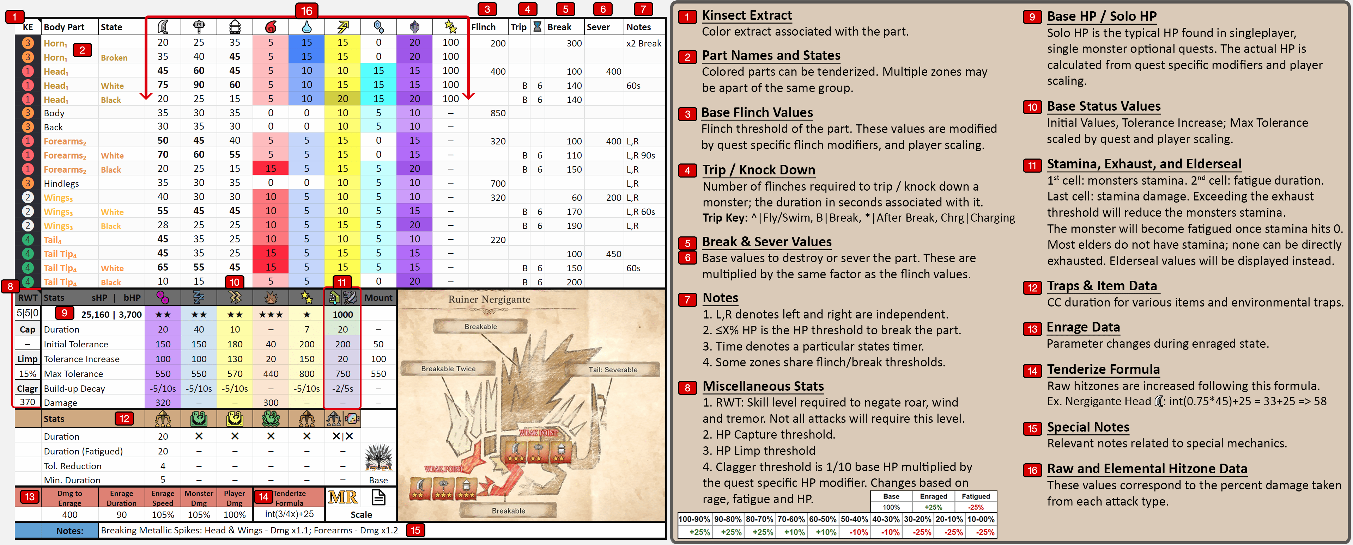

Let’s Talk Advantages: Domain Knowledge
Domain Knowledge: topical info about the data itself unrelated to Data Science
When you’re already familiar with your data, it’s easier to work with it!
Oh, it’s more Monster Hunter.
Again. Thanks Bri.
What does any of this mean?

Slide 8
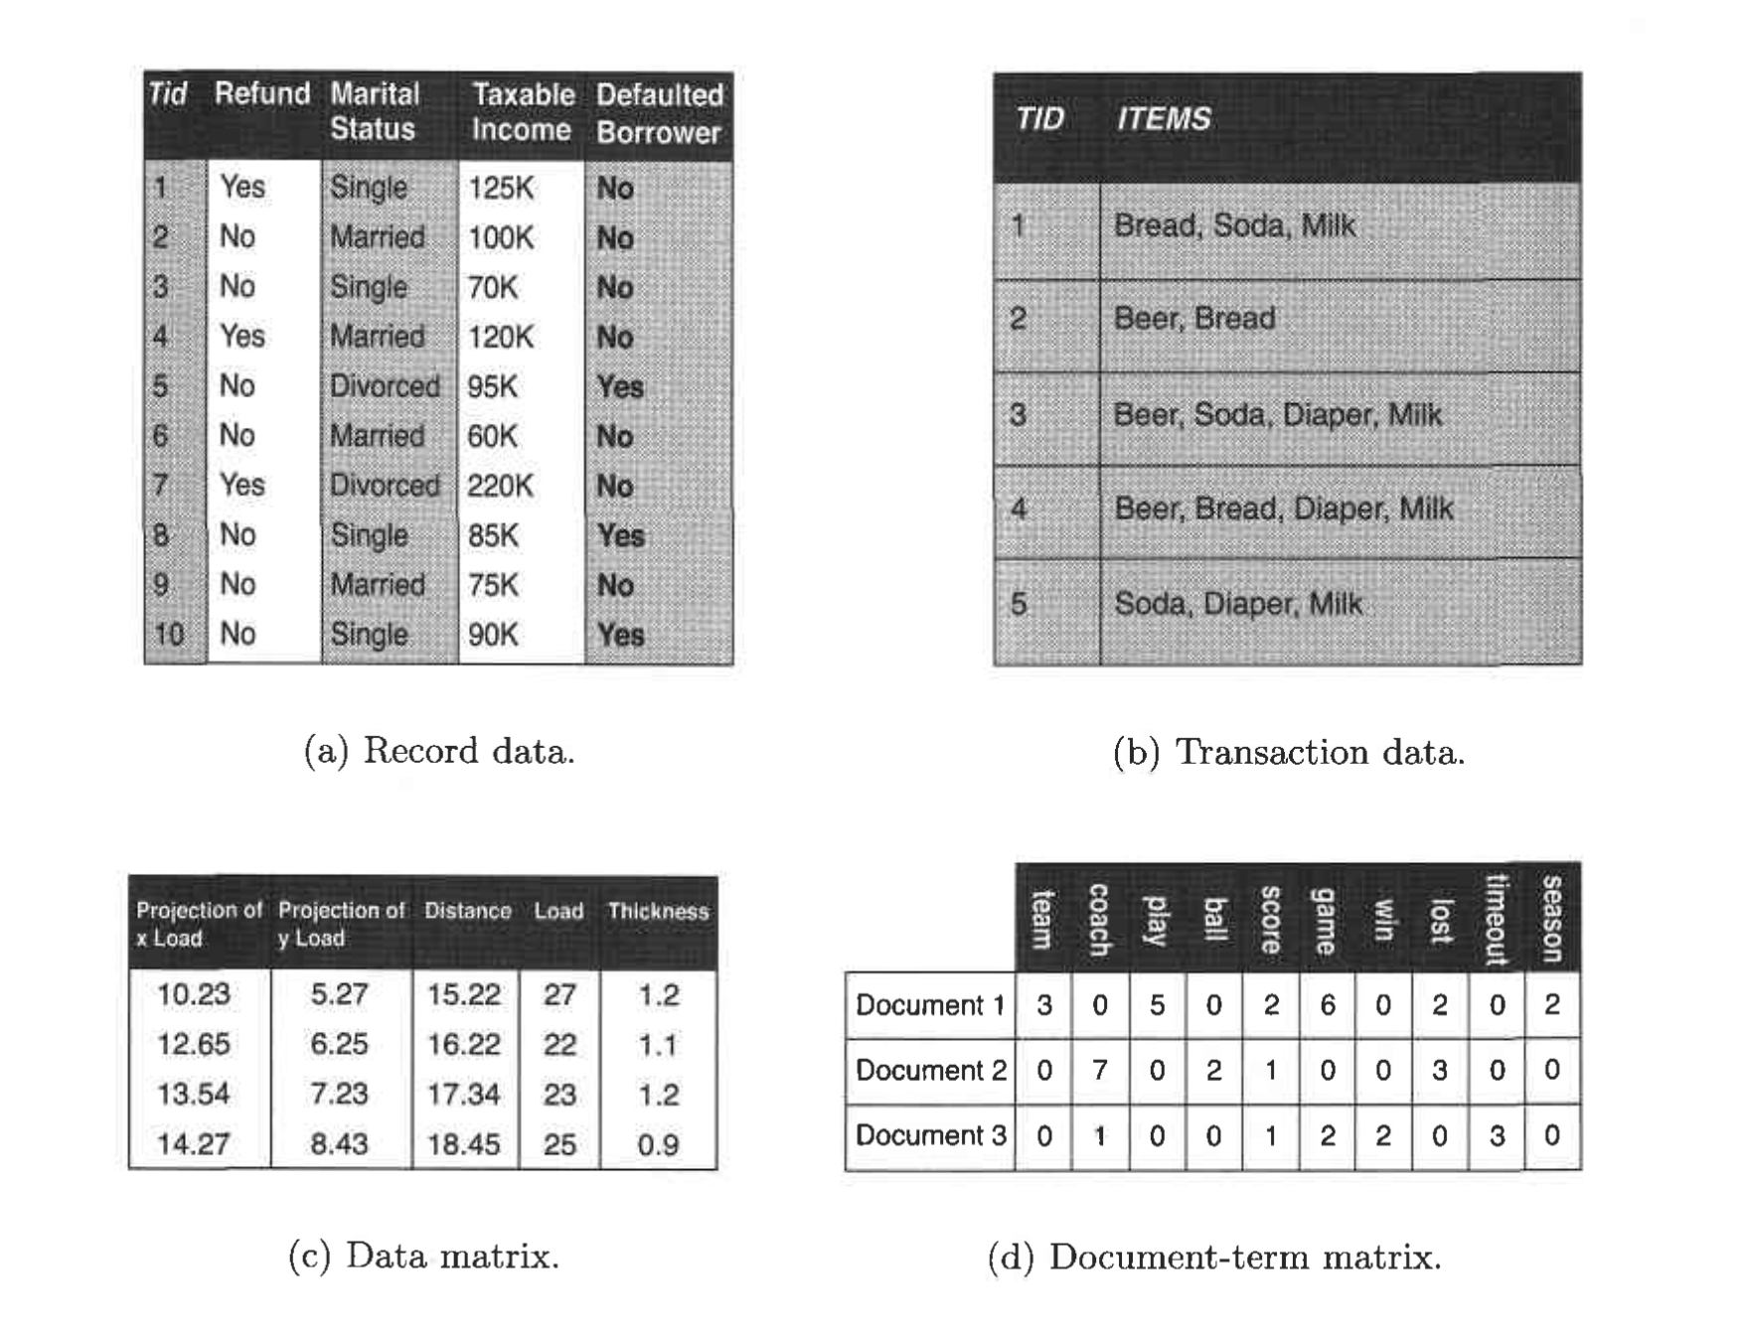
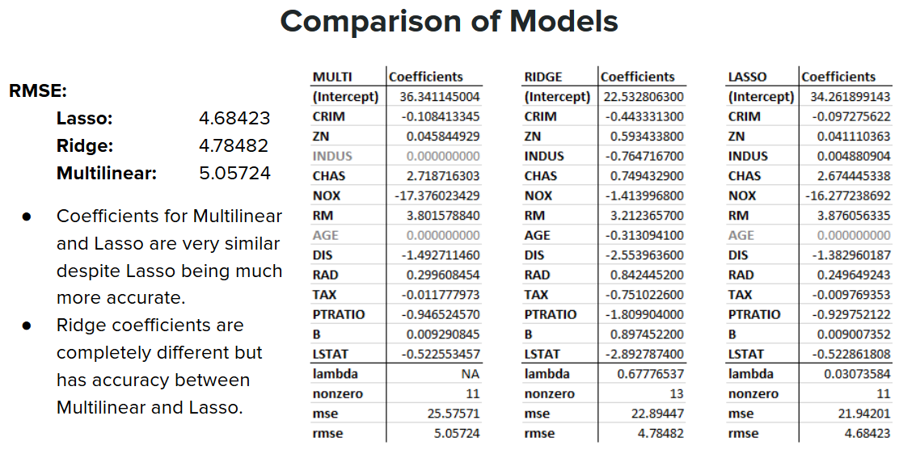
Let’s Talk Advantages: Stay Focused
When you don’t care, it’s a slog. It’s probably even less interesting when you show it off.
Who cares?
Notes:
https://medium.com/nightingale/so-you-want-to-make-a-hockey-data-viz-dda7b347f117 https://public.tableau.com/profile/meghanhall#!/vizhome/GoaliePullTimes2018-19/GoaliePullTimes18-19

Slide 9
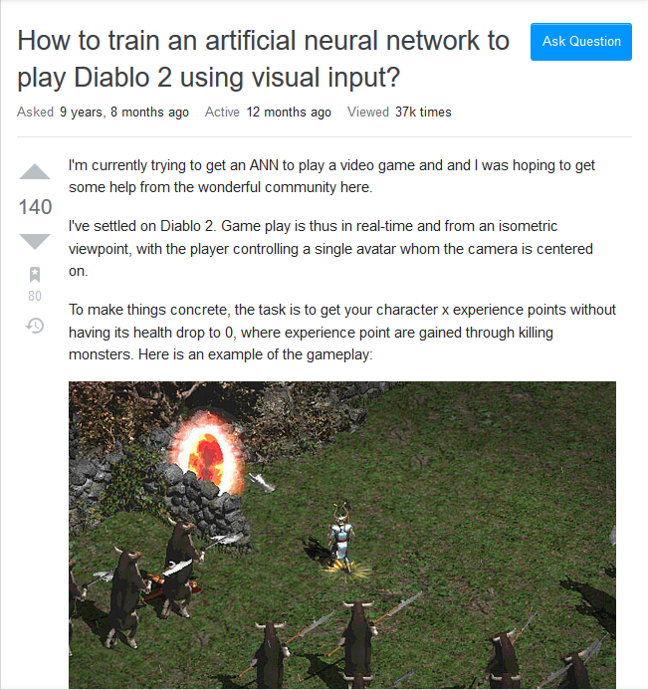
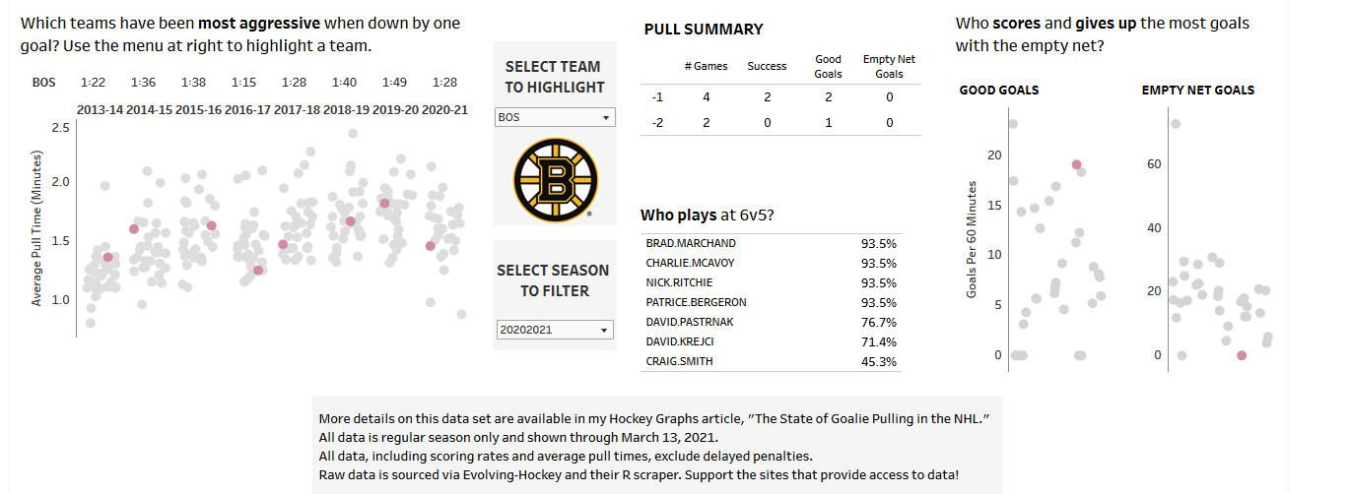
Let’s Talk Advantages: Stay Focused
But when you DO care, it’s like you’re not even working!
https://medium.com/nightingale/so-you-want-to-make-a-hockey-data-viz-dda7b347f117
Notes:
https://medium.com/nightingale/so-you-want-to-make-a-hockey-data-viz-dda7b347f117 https://public.tableau.com/profile/meghanhall#!/vizhome/GoaliePullTimes2018-19/GoaliePullTimes18-19

Slide 10
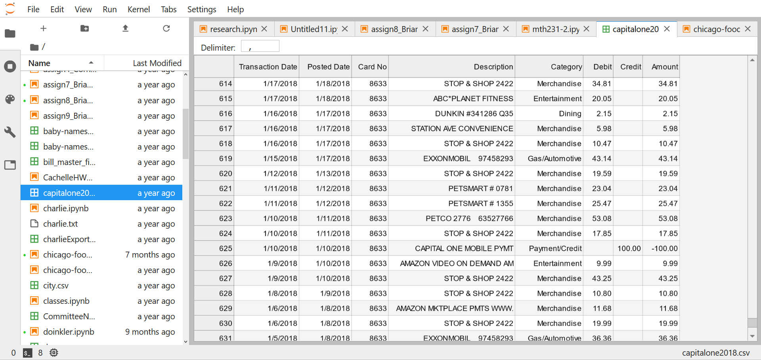
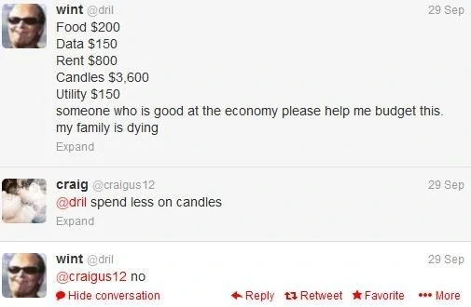
Let’s Talk Advantages: Improve Your Well-Being
…or not!
Real data from my credit card history!
Many services let you download your personal data records as .csv or Excel files.
You can use these to not only improve your DS skills, but also improve your quality of life!

Slide 11
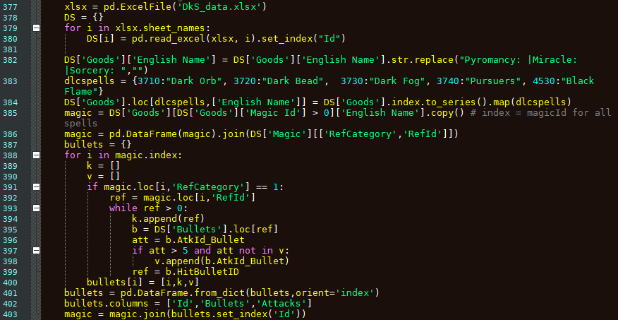
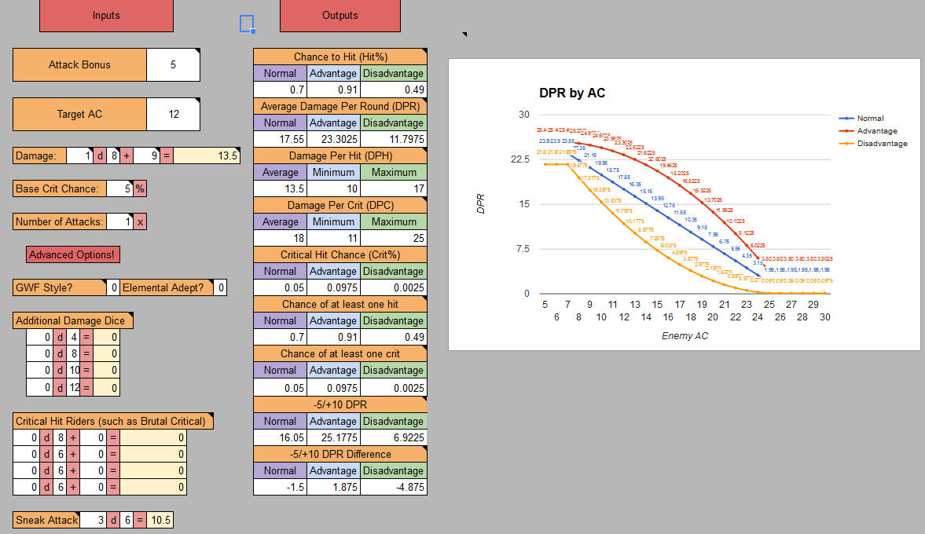
Remember: Nothing is a Waste of Time
Simply trying is a good experience – cultivate your skills by doing something
This is a good look for interviews!
Coding!
Visualizing!
Notes:
https://medium.com/nightingale/so-you-want-to-make-a-hockey-data-viz-dda7b347f117 https://public.tableau.com/profile/meghanhall#!/vizhome/GoaliePullTimes2018-19/GoaliePullTimes18-19

Slide 12
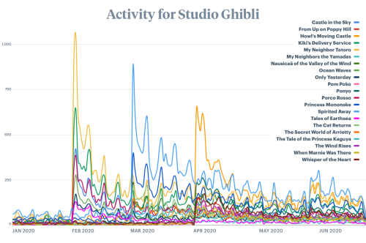
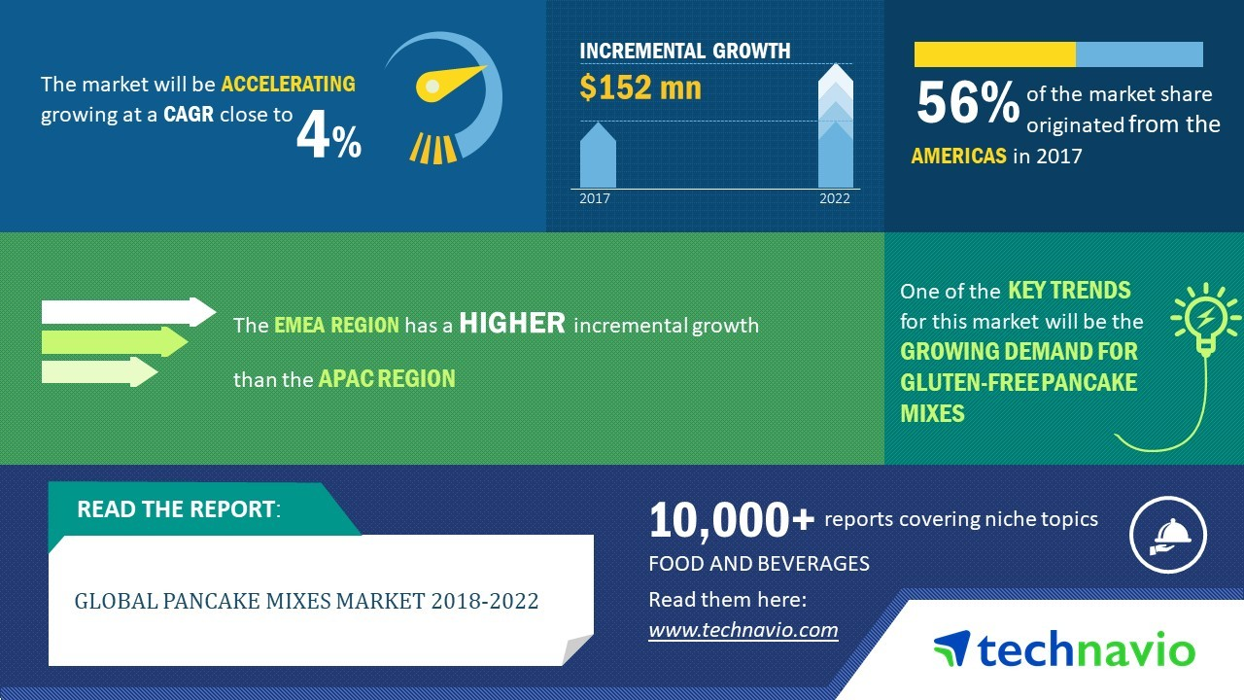
Remember: Nothing is a Waste of Time
Anything you have an interest in can be relevant in the world of business
There’s no such thing as a dumb topic – YOU decide if it’s worth doing
Your favorite movies!
Your favorite breakfast!
Notes:
https://medium.com/nightingale/so-you-want-to-make-a-hockey-data-viz-dda7b347f117 https://public.tableau.com/profile/meghanhall#!/vizhome/GoaliePullTimes2018-19/GoaliePullTimes18-19

Slide 13


Remember: Nothing is a Waste of Time
You tend to meet the people you’d want to meet when you do what you love!
Make friends!
Find true love!
Notes:
https://medium.com/nightingale/so-you-want-to-make-a-hockey-data-viz-dda7b347f117 https://public.tableau.com/profile/meghanhall#!/vizhome/GoaliePullTimes2018-19/GoaliePullTimes18-19

